Slide 1
Freeswitch on pfSense
Prepared For:
Toronto Asterisk User Group
Presented by:
David Donovan
March 24, 2009

Slide 2
Topics to be Covered
Introduction and history of pfSense
Introduction and history of FreeSwitch
Installing and configuring pfSense
Installing and configuring FreeSwitch
Typical configurations
Q&A

Slide 3
The Presenter: Who’s this guy?
David Donovan
Started my career as a Network Admin and then IT Manager for an outsourced call centre
First applied Asterisk 5 years ago for recorded announcements in a Lucent Definity environment
Did Project Management and IT Consulting for a few years including a few small Asterisk projects: IVR, PBX
Currently IT Manager for Nuvo Research, a small public Canadian Biotech focused on topicals

Slide 4
The pfSense Project - Overview
What is it?
A free, open source firewall router
BSD based (currently 7.1)
Relatively easy to set up
Supports add-on packages like squid, FreeRadius, sipproxd, snort, TinyDNS
Supported commercially by the developers and freely by an active user community
Lean 76 meg ISO image. Can run from CD or install to hard disk
Supports full PC and embedded devices like ALIX, WRAP and Soekris

Slide 5
The pfSense Project - Overview
Where did it come from?
Based on BSD (currently 7.x) and pf
Started in 2004 by Chris Buechler and Scott Ullrich as a friendly fork of m0n0wall
m0n0wall is strictly for embedded setups, pfSense offers full PC as it’s main focus and embedded as well

Slide 6
The pfSense Project - Overview
Where is it going?
Focus is on release version 2.0 currently in alpha
2.0 based on BSD 7.1 which provides better hardware support
Direction is toward becoming a platform to build robust, stable appliances such as DNS servers, PBXs, Firewalls, etc.

Slide 7
The Freeswitch Project
Started by Anthony Minesalle when he realized that Asterisk and some of it’s core design issues were holding him back
(lots more on this on the Freeswitch website, see resources on last slide)
Open architecture, focused on being developer friendly and pluggable
Uses the Sofia SIP stack instead of Asterisk home-rolled SIP stack

Slide 8
The FreeSwitch Project
FreeSwitch is generally acknowledged to be better at conferencing than Asterisk
Compiles natively in Linux, BSD and Windows
Uses XML for all of it’s config files so they are more parsing friendly
Supports SIP, IAX, H263, Zaptel (Digium), Wanpipe (Sangoma) and many others

Slide 9
Installing PfSense
Requirements (for PC based builds):
  At least one physical network card (two or more would be great)
  I’ve had no problem using PIIIs with 128MB RAM for home machines
  I use a couple of low-horsepower Dell P4s at my branch offices
  CD ROM drive
  Keyboard and monitor are optional after the initial install process is complete

Slide 10
Installing PfSense
Drop the CD in, boot your machine
Use autodetect to find and label your network interfaces
(recommended) Choose option 99 to install to Hard Disk
Follow the prompts
– HUGE WARNING – This will erase all the data on your hard drive permanently, forever and irrevocably. (You won’t be able to get it back either)

Slide 11
Installing PfSense
Other than setting the timezone, I’ve always been able to accept the defaults while installing
Pop the CD out and let it reboot
Connect to the LAN interface using a web browser. U: admin, P: pfsense
From the system menu, run the ‘Setup Wizard’

Slide 12
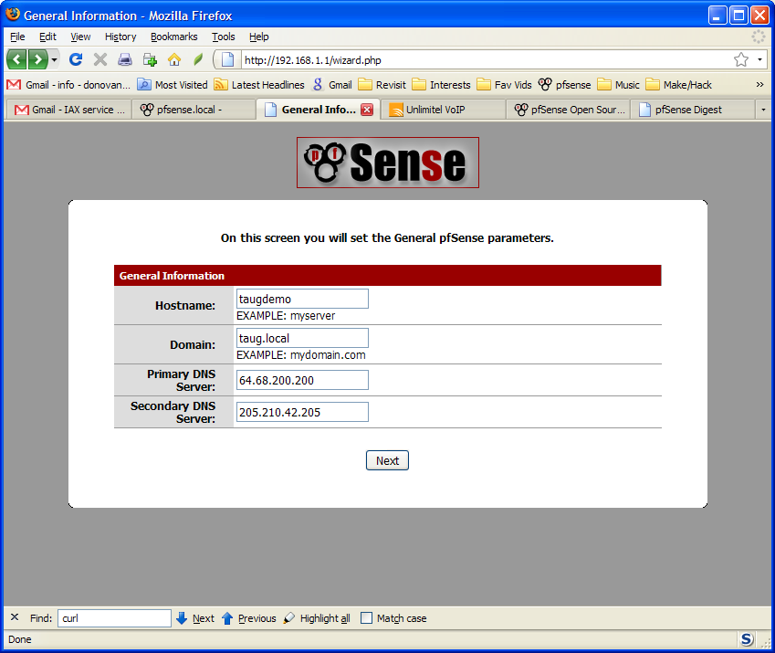
Installing PfSense

Slide 13
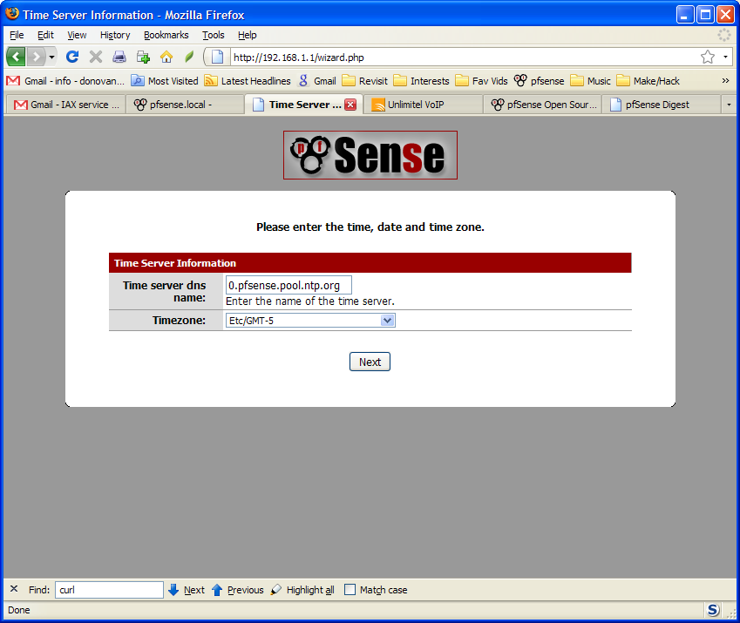
Installing PfSense

Slide 14
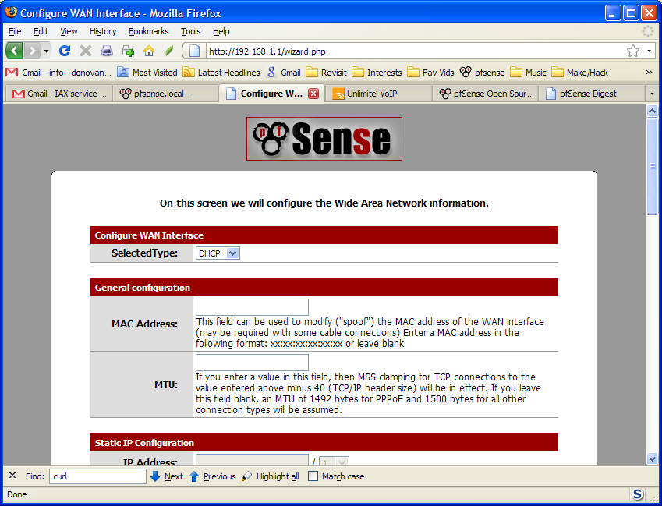
Installing PfSense

Slide 15
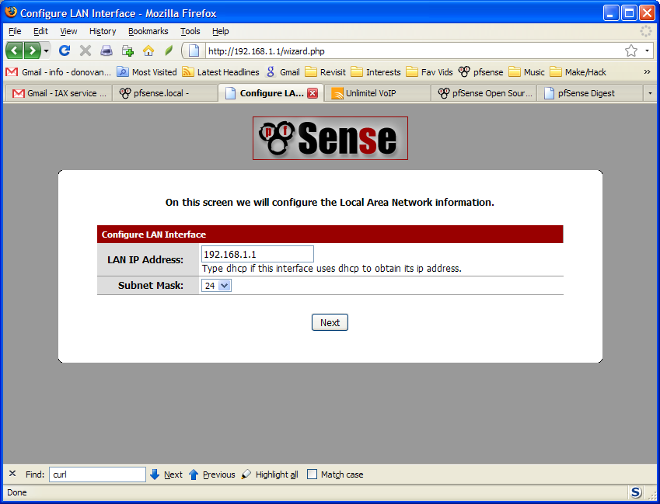
Installing PfSense

Slide 16
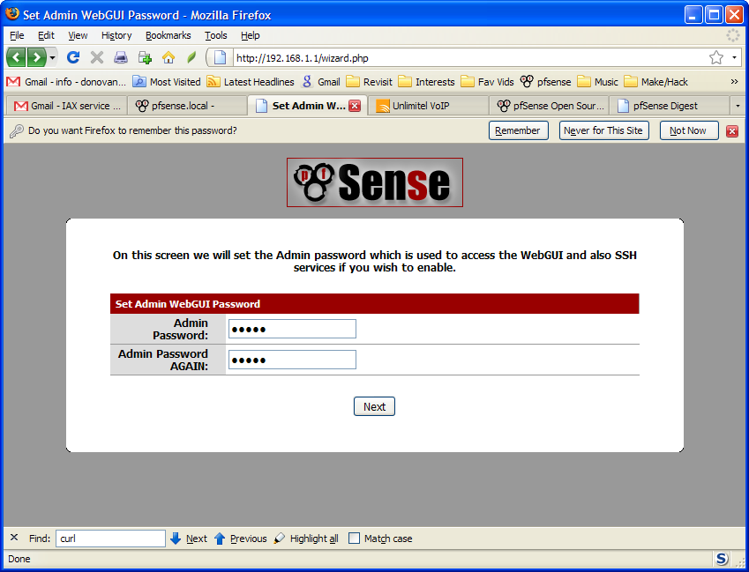
Installing PfSense

Slide 17
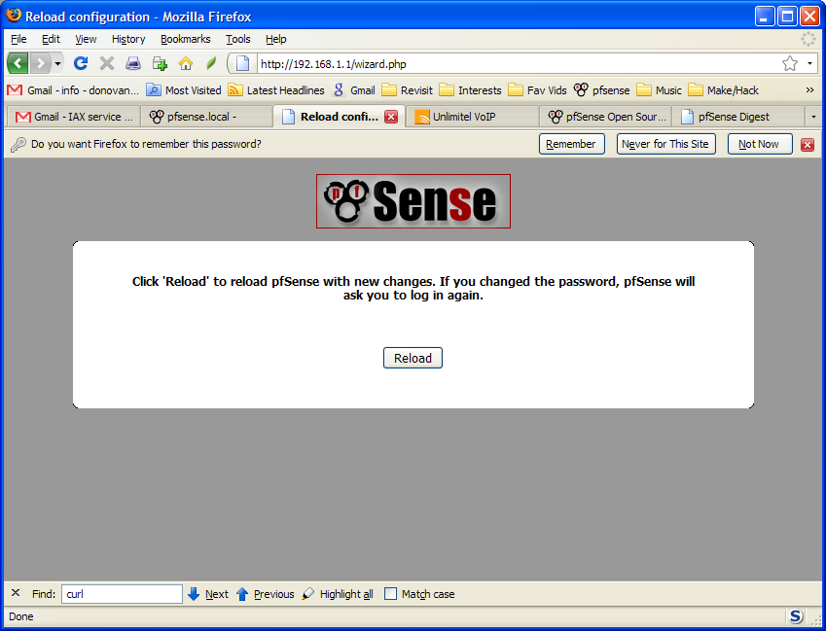
Installing PfSense

Slide 18
pfSense – Other features
Captive Portal
VPN: IPSec, PPTP, OpenVPN
Wireless client, Wireless AP
FreeRadius
Packet Capture
Snort IDS

Slide 19
Installing and configure FreeSwitch
The best resource for this process is:
http://doc.pfsense.org/index.php/FreeSWITCH
The following slides will give you a flavour of the interface but don’t provide config info, see the wiki link for that

Slide 20
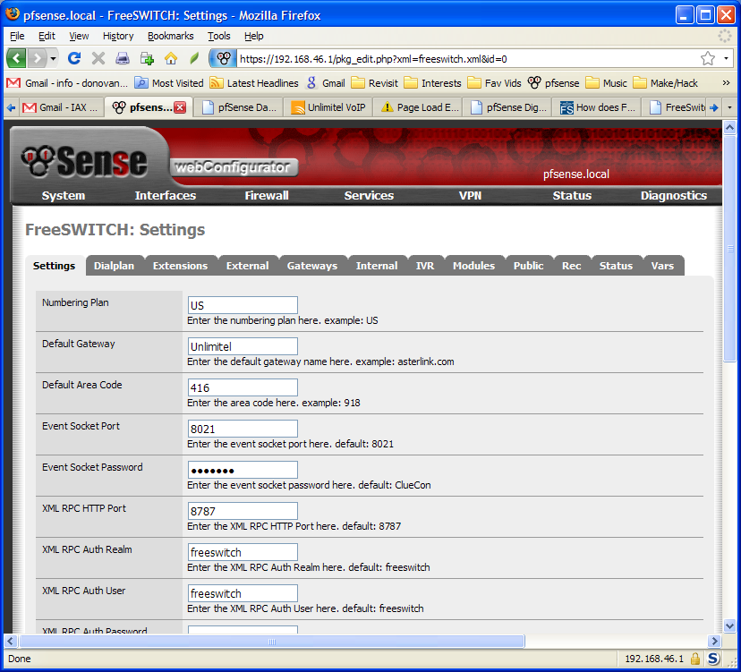
Installing and configure FreeSwitch

Slide 21
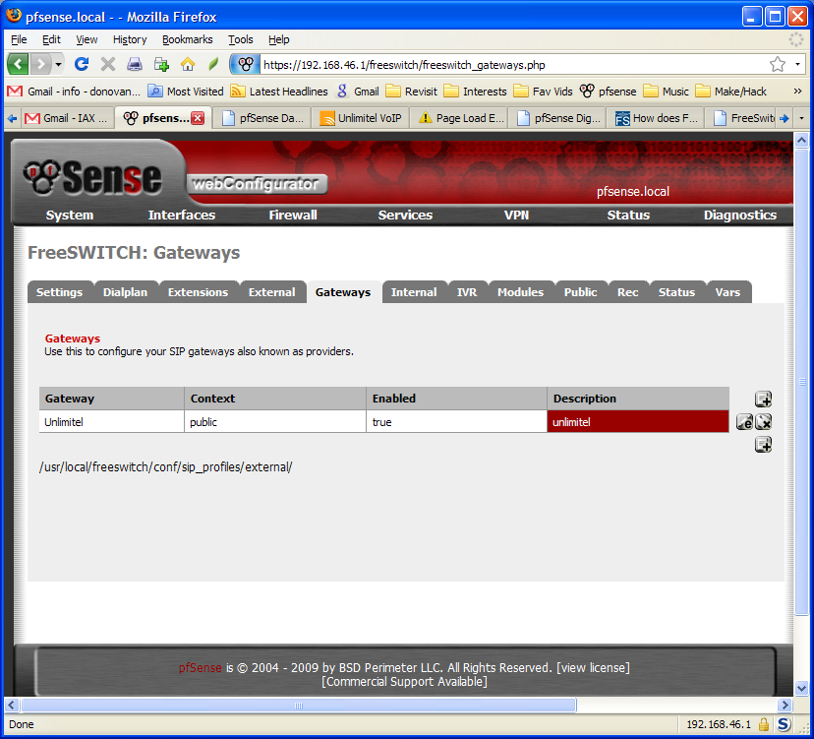
Installing and configure FreeSwitch

Slide 22
Benefits FreeSwitch
Supports one to many multi-party video conferencing. The system guesses who is speaking and sends that video to all participants
Using it on your firewall can eliminate NAT traversal because it binds (by default) to the external interface IP
Many others depending on your application

Slide 23
Links and Resources
The pfSense project can be found at www.pfsense.org
Watch for news on version 2.0 at blog.pfsense.org
The pfSense forums and mailing lists are friendly and helpful. The lead developers participate daily
Other open source firewall packages worth looking at include Untangle and m0n0wall:
www.untangle.com
m0n0.ch

Slide 24
Links and Resources
The FreeSwitch website has a periodically updated blog and links to downloads and the wiki:
www.freeswitch.org
Here’s a good starting point on understanding where FreeSwitch is coming from, and where it’s going especially as it compares to Asterisk:
www.freeswitch.org/node/117

Slide 25
Q&A
Thanks for your kind attention.
The conversation continues….
Visit www.taug.ca/discuss and join the TAUG mailing lists and come out to events.

